Slide 1
DR : Dynamic Indoor Obstacle Avoidance and Navigation
Nagarjun Vinukonda & Kavit Shah
Guide : Zhi Li
Mentor : Kenechukwu Mbanisi

Slide 2
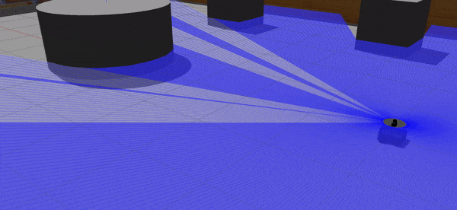
Why Do We Care?
Agreed path planning is crucial for Autonomy in a robot
But is it sufficient in itself?
The obvious answer is NO!

Slide 3
Introduction
Problem Statement : To develop an obstacle & collision avoidance system for the purpose of assistive autonomy of mobile robot teleoperation
Eg: A teleoperated nursing robot taking velocity taking velocity commands from user but modifying them if it find itself in a possible future collision
Motivating Goal : We try to device a dynamic obstacle avoidance system with minimal computation costa by utilizing simple sensors like LiDAR but still achieving profound and highly scalable results.

Slide 4
Deliverables
Base Goals:
Review on dynamic obstacle avoidance. ✔
Identify the methods applicable to the assisted navigation of nursing robot in cluttered human environment for assistive robot autonomy ✔
Implement the selected navigation assistance (collision avoidance) (✔) and integrate with GUI in ROS (X)
Test it with different environmental variables (such as number of obstacles/humans, their speeds, etc.) ✔
Test individual and combined navigation assistance, on the nursing robot control with 3 dof joystick and driving cockpit (X)
Report for the project (✔)
A demonstration (✔)

Slide 5
Related Work
As old the field of motion planning is, somewhat similar is the field of obstacle avoidance.
The dynamic obstacle avoidance has been approached in a number of ways :
Path based planning and optimization
Velocity based planning
Uncertainty based
Traditional methods
Bio-inspired methods
MPC based methods
… and the list goes on
But of them all Velocity based methods are a charm.

Slide 6

Related Work : VO Based approach
Algorithm | Performance | Application
VO | > Initiation of idea Not useful in practical > All higher algorithms develop from here > Suffers from oscillations | Mobile Robots
RVO | > Provided a good development over VO. > Basis for higher algorithms > Oscillation if more than 2 obstacles | Mobile Robots
ORCA | > Guarantees collision avoidance > Highly scalable > Converts the problem into LPP | Mobile robot navigation in a social aware environment
Proxemics | It requires both fairer judgment and more precise measurements to collect social cues and signals. | Using Proxemics for building human-centred potential fields along with RRT* for avoiding human space invasive navigation.It is a Risk-based algorithm for collision avoidance and A* for finding shortest route.
More exhaustive literature review summary could be found in the “literature summary.doc” in the submission folder
Notes:
Baysian
Q-Learning: Performance:
It provides Accurate information, guarantees collision avoidance but more computationally expensive.
Application: Mobile robots

Slide 7
Methodology: Framework
Localization
Robot Controller
Sensors (LiDAR)
Mapping
tf
scans
velocity
Reactive Planner
(ORCA)
Pedestrian Detection & Tracking
Agent data
-header (header)
-agent_ID (int)
-data (_agent)
-position (vector2)
-velocity (vector2)
-radius (int)

Slide 8
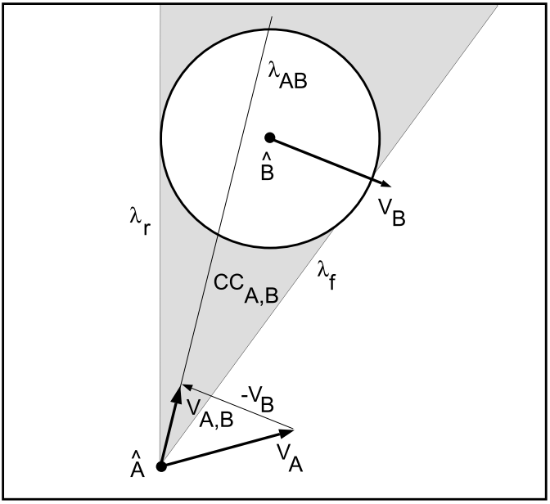
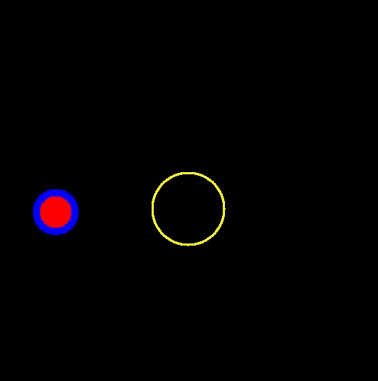
Methodology: ORCA
ORCA or Optimal Reciprocal Collision Avoidance is a highly efficient and scalable algorithm
Checks if current velocity leads to collision and if yes, computes minimum change in velocity to avoid collision
It further simplifies problem by converting into LPP
Considers reactiveness of obstacles
Scalable in terms of multiple robots & multiple obstacles

Slide 9
Methodology : Object Tracking
Laser scan
The aim of this package is to determine radius, position and velocity of obstacles. scan_merger:
It subscribes 2 laser scans from split_scan package and merge them.
It converts the scan data into pointcloud.
obstacle_extractor:
It subscribes scan_merger data and creates circular obstacles and line_segments using ICP algorithm.
obstacle_tracker:
It subscribes obstacle_extractor data and supplements with velocity of obstacles using Kalman filters.
scan_merger
obstacle_extractor
obstacle_tracker
Tracked obstacles

Slide 10
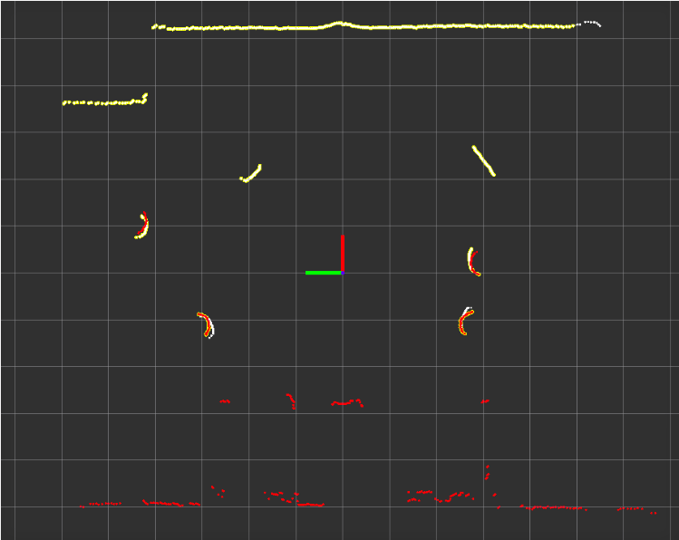
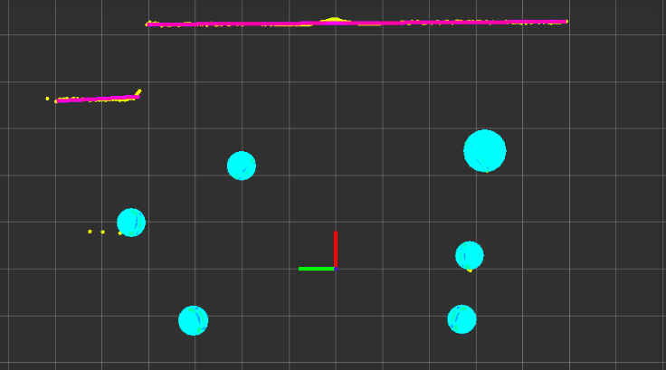
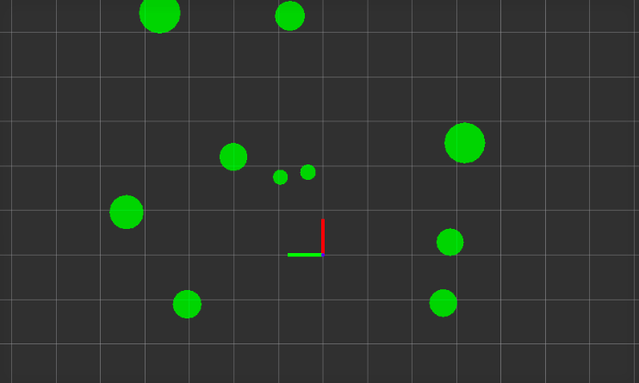
obstacle_extractor
scan_merger
obstacle_tracker

Slide 11
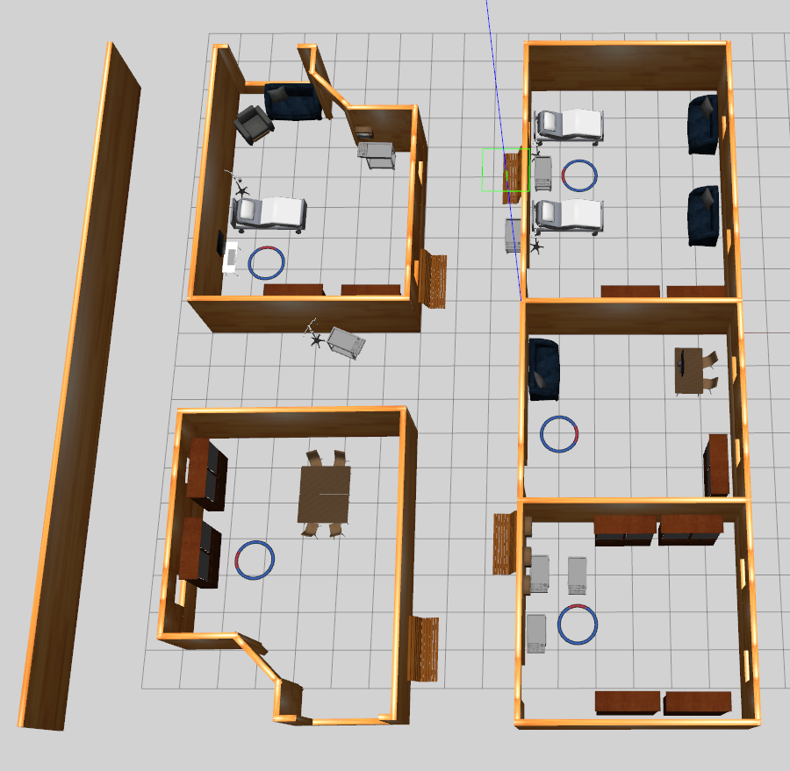
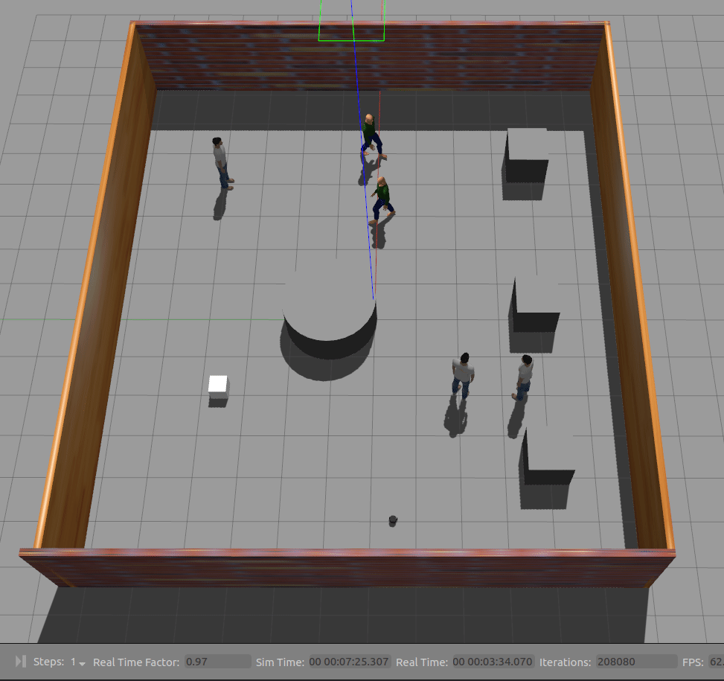
Experiments : Simulation Environment
Hospital Aisles & Rooms
Hospital Lobby

Slide 12
Experiment Obstacle-extractor: parameter tuning
Important parameters used for obstacle extractor:
Grouping
Parameter | Description
Min_group_points (N_min) | Minimum no.of points to create a group
Distance_proportion (d_p) | Allowable distance between points
Max_group_distance (d_group) | Create group points d > d_group
Radius_enlargement (r_merge) | Enlarge radius
Max_circle_radius (r_max) | Discard obstacle radius > r_max
Splitting
Line segmentation
Extract Obstacles
Merge Obstacles

Slide 13
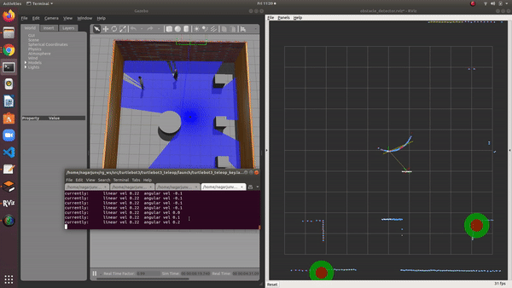
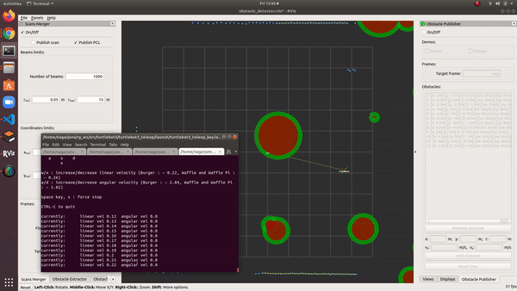
Experiments: Initial results & Failures
Unable to group the small pcl.
Unnecessary obstacles formed on wall.
Cannot detect all obstacles sizes robustly.
No proper tracking.
Discarding obstacles which are off limits from local distance to robot.
Transformations of obstacle positions are not accurate.
Notes:
The package is tested tracking & obstacle_extractor for increased velocity of Human and robot.
Limit: The turtlebot should not rotate so fast. Rmax: 0.7 m/s

Slide 14
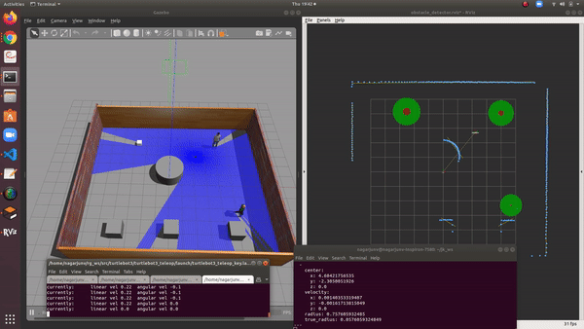
Experiment Obstacle-tracker: Human & obstacle detection
HIghLights:
Max distance to detect moving human: 6m
Max robot rotation rate: 0.7 m/s
Laser scan range: 15m
Parameters:
Parameter | Value | Action
N_min | 2 | Decrease
d_p | 0.09 | Increase
d_group | 0.4 | Decrease
r_merge | 1 | Increase
r_max | 0.7 | Increase
Notes:
The tracking of obstacles takes place only if obstacles are formed.
The point clouds are small for human legs are very small to create obstacles
More the point clouds better the detection.

Slide 15
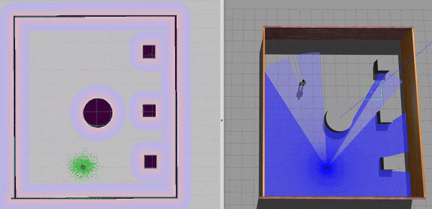
Experiments : ORCA - General Cases
Successful ORCA trials in hospital lobby in static-world
This has been tried for trying to navigate the robot from different start and goal positions
Each time the robot navigates without collision.
However, there is a special case of robot approaching obstacles head-on which needs consideration

Slide 16
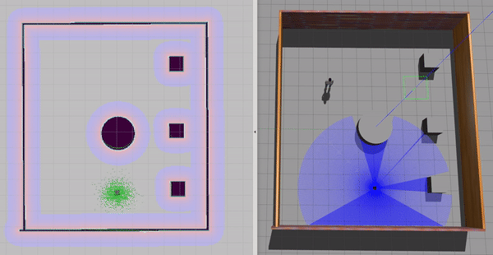
Experiments : ORCA - Special Cases
The scenario of robot approaching the obstacle head-on is a critical case
Fine-tuned ORCA hyper-parameters
Robot Laser Scan range
Time-horizon to obstacles *
Preferred Velocity **
Metrics:
Success Rate (%)
Avg. Min Clearance (m)
Avg. Completion Time
Sim speed = 3x
Notes:
Robot takes too much time for navigating here in head on
So we use a few hyper-parameter tuning
Robot Laser Scan : The range of laser
Time horizon to obstacle : How far from current state should robot consider presence of its obstacle
Preferred Velocity : This is the “current robot velocity” which is used by the algorithm to estimate collision .. we do not change the velocity as such. We just SCALE it.
Metrics to test it :
Success Rate : In trials of 3 for each Th_obst, we % success rate i.e. no collisions
Avg. Min Clearance : Average of minimum robot clearance from surrounding obstacles from each trial
Avg.Completion Time : Average of amount of time to complete each trial

Slide 17
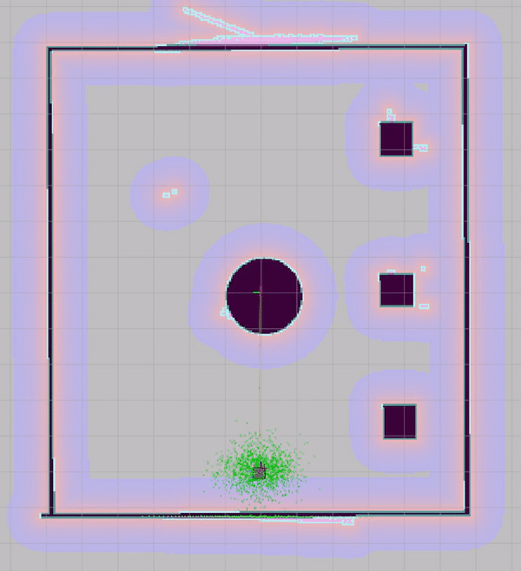
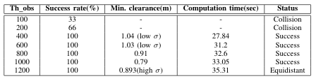
Experiments : ORCA Hyper-parameter tuning
Laser Scan Range = .3.5m
V_pref scaling factor = 1
Th_obs of 400 is quickest
Th_obs 400 & 600 have low std. deviation
Th_obst = 400
Min. clearance = 0.96m
Total time = 28.36 sec
Notes:
Th = 400 & 600 are consistent i.e in both of them the robot moves through the same side of the static obstacle always
The interesting thing for laser_range = 3.5m is that the robot always moves EQUIDISTANT to the other obstacles in its surroundings, which was not the case for laser scan = 5m
If given a choice to choose The Scan Range, Would be advantageous and viable to choose ScanRange = 3.5m with Th = 400 / 600.
But it would be interesting to find out if this is a generalized observation or a robot-based?

Slide 18
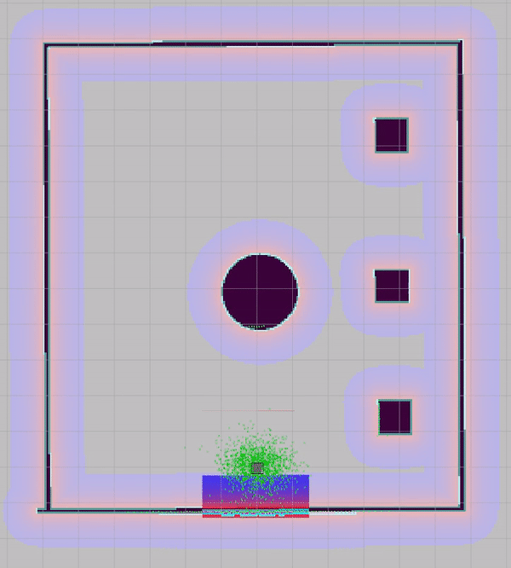
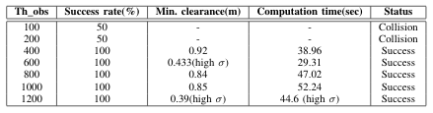
Experiments : ORCA Hyper-parameter tuning
Laser Scan Range = 4m
V_pref scaling factor = 1
Th_obs of 600 is quickest
Th_obs 600 has high std. deviation (depends on side motion)
Th_obst = 600
Min. clearance = 0.86m
Total time = 27.574 sec
Notes:
The computation time is fastest for Th = 600 is the fastest, While its clearance is too less as compared to others. It is not always LESS so as to speak, but in 50% situations its min clearance is 0.45m & for remaining 50% situation, its clearance is 0.92, meaning it has high variance.
The computation time on the other hand for th = 400 is slightly high than for Th = 600, but it ensures good clearance always.
The most interesting takeaway here is, if given an opportunity for Scan=4m, it could be advisable to choose Th = 1200. It moves FARTHER away from the circular obstacle at the center, but moves closer to other obstacles in the environment. (This seems to be a strange-point of ORCA). On the other hand, The computation time for Th=1200 is around 30sec (which is fast) with 75% probability while 80sec with 25 % probability. Thus giving a high variance

Slide 19
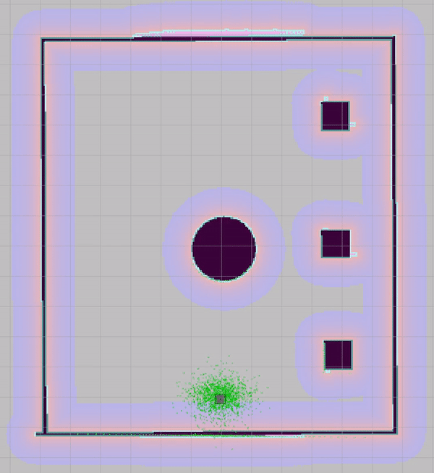
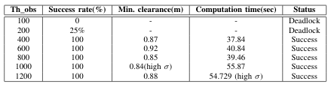
Experiments : ORCA Hyper-parameter tuning
Laser Scan Range = 5m
V_pref scaling factor = 1
Th_obs of 400 is quickest
Th_obs increases, time increases
Th_obst = 400
Min. clearance = 0.92m
Total time = 38.869 sec
Notes:
For Th = 100 & 200, the robot gets stuck in a dead lock right next to the obstacle.
At around Th = 400, the robot just skims right past the obstacle, but is fast
As Th further increases to Th - 600, its clearance increases.
What do we take away from this graph?
When robot laser range is constrained to 5m, it would be more advantageous to set Th_obs = 600 instead of 400
It would take almost little longer amount of time to robot for Th = 600, but would be at a better clearance, which would be advisable
Gets too slow, way too slow as time horizon to obstacle increases, so higher Th, not so good

Slide 20
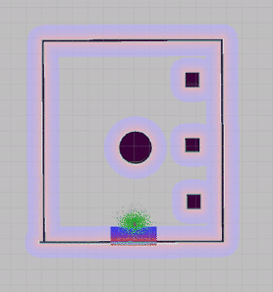
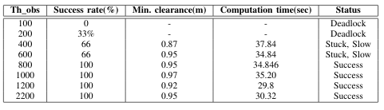
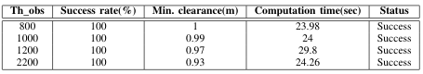
Experiments : ORCA Hyper-parameter tuning
Laser Scan Range = 10m
V_pref scaling factor = 1
V_pref scaling factor = 2
Notes:
The initial trials LED US TO A FALSE BELIEF THAT SHORTER TO Laser range is better. But on talking to Kene, we realized, it would be advantagoes to use larger scans
This was the first exp where we started changing v_Pref
This is by far the best performance on all the test so far.
The robot shows exceptional performance improvement as it can see too ahead into the future to check for collision
Also changing v_pref from 1 to 2 gets *Significant improvement in results and robot tries to solve the problem on head-on collision smoothly.

Slide 21
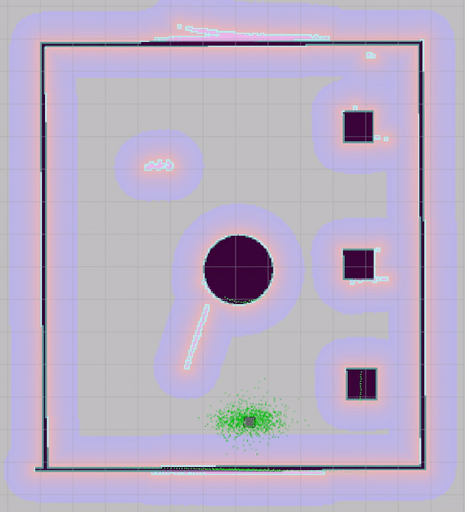
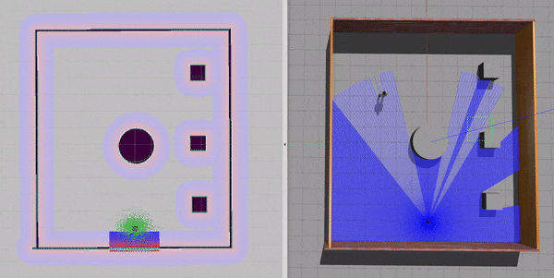
Simulation Results : ORCA + Lobby
Notes:
Successfully achieved Point To Point Robot Navigation using ORCA with just Static Scans of the env.
Achieved this in the most crucial & pivotal start and end goal configuration

Slide 22
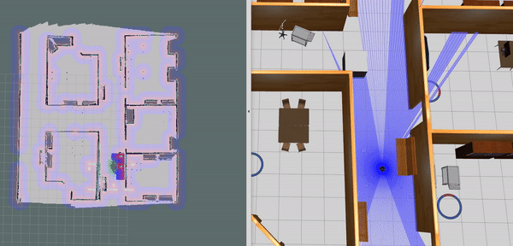
Simulation Results : ORCA + Hospital World
Notes:
Th = 400 & 600 are consistent i.e in both of them the robot moves through the same side of the static obstacle always
The interesting thing for laser_range = 3.5m is that the robot always moves EQUIDISTANT to the other obstacles in its surroundings, which was not the case for laser scan = 5m
If given a choice to choose The Scan Range, Would be advantageous and viable to choose ScanRange = 3.5m with Th = 400 / 600.
But it would be interesting to find out if this is a generalized observation or a robot-based?

Slide 23
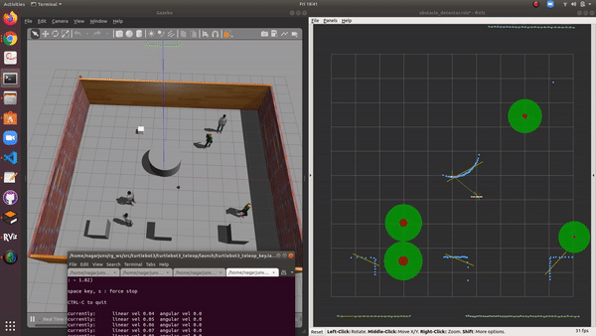
Simulation Results : Obstacle tracker + Human
single-Human
Multi-Human
Notes:
These results show obstacle tracking in cluttered human environment. The limitation of this package is depended upon what kind of obstacles available in environment. Currently, it is best tuned for humans and smaller obstacles.

Slide 24
Simulation Results : Extra Modules
Semi-autonomous Navigation Mode
To work in conjunction with remote human teleoperator
It will take “preferred velocity” commands from the human which it would try to compute
Aids the need for Assistive Autonomy
Autonomous Navigation Mode
To work in conjunction to the global & local planners
It will take goal positions and will drive the robot to the goal with active collision avoidance using ORCA’
Aids the need for Complete Autonomy

Slide 25
Integration of two packages
Unfortunately due to large code base & shortage of time we are not able to integrate the ORCA package together with the Obstacle Tracking package
However, the Obstacle Tracking package is fully functional and transmits the required ROS message via ROS topics. The integration of ORCA to dynamic obstacles is in development (We extend this to future work)

Slide 26

Challenges Faced
ORCA :
Deciphering the RVO2 (ORCA) & the obstacle tracking libraries with large code base developed in C++
Integrating the RVO2 with ROS (static-world)
Fine-tuning the hyper parameters
Integrating changes in the large code base to tweek it for dynamic obstacles & humans
Obstacle tracker :
Understanding the package to tune robustly according to the obstacles required to detect.
Integrating package to turtlebot and sending customized messages to ORCA.
Robust detection of humans.

Slide 27
Lessons Learned
The deeper the literature review the stronger the knowledge base.
Always document the code well enough for making it easy for others to understand.
Moreover, it is necessary to develop & (stick to) a proper timeline for the project
How to integrate different packages, ROS.
Strengthened our understanding in programing in c++.

Slide 28
Discussion and Future Scope
ORCA works well for Static Scenarios (as tested)
Even still, it has some limitations
Major limitations:
workable range of sensor readings
accurate positioning of map & odom frames in ROS
Modifications & future work:
Adjust the library to accommodate moving objects
Can make the laser scan as a cycloidal shape to emphasize more on obstacles right in front of it
Modify the hyper-parameters to generalize it for all scenarios.
Add a machine learning module to track and detect humans &/or objects
Classification of obstacles into stationary, movable or mobile and application of appropriate KF parameters.

Slide 29
References:
Fiorini, Paolo, and Zvi Shiller. "Motion planning in dynamic environments using velocity obstacles." The International Journal of Robotics Research 17.7 (1998): 760-772.
Large, Frederic, et al. "Using non-linear velocity obstacles to plan motions in a dynamic environment." 7th International Conference on Control, Automation, Robotics and Vision, 2002. ICARCV 2002.. Vol. 2. IEEE, 2002.
Van den Berg, Jur, Ming Lin, and Dinesh Manocha. "Reciprocal velocity obstacles for real-time multi-agent navigation." 2008 IEEE International Conference on Robotics and Automation. IEEE, 2008.
Wilkie, David, Jur Van Den Berg, and Dinesh Manocha. "Generalized velocity obstacles." 2009 IEEE/RSJ International Conference on Intelligent Robots and Systems. IEEE, 2009.
Van Den Berg, Jur, et al. "Reciprocal n-body collision avoidance." Robotics research. Springer, Berlin, Heidelberg, 2011. 3-19.

Slide 30
References:
Papers:
Snape, Jamie, et al. "The hybrid reciprocal velocity obstacle." IEEE Transactions on Robotics 27.4 (2011): 696-706.
Van Den Berg, Jur, et al. "Reciprocal collision avoidance with acceleration-velocity obstacles." 2011 IEEE International Conference on Robotics and Automation. IEEE, 2011.
Bareiss, Daman, and Jur van den Berg. "Generalized reciprocal collision avoidance." The International Journal of Robotics Research 34.12 (2015): 1501-1514.
Kim, Sujeong, et al. "Brvo: Predicting pedestrian trajectories using velocity-space reasoning." The International Journal of Robotics Research 34.2 (2015): 201-217.

Slide 31
References
Gopalakrishnan, Bharath, et al. "Prvo: Probabilistic reciprocal velocity obstacle for multi robot navigation under uncertainty." 2017 IEEE/RSJ International Conference on Intelligent Robots and Systems (IROS). IEEE, 2017.
Packages & Libraries:
https://github.com/tysik/obstacle_detector
http://gamma.cs.unc.edu/RVO2/

Slide 32
Appendix : Additional Parameters of Object Tracking
Parameter | Description
Min_group_points (N_min) | Minimum no.of points to create a group
Distance_proportion (d_p) | Allowable distance between points
Max_group_distance (d_group) | Create group points d > d_group
Max_split_distance (d_split) | split a group point d > d_split
Max_merge_spread (d_spread) | Merge line segments, if extreme points d < d_spread
Max_merge_separation (d_sep) | Merge obstacles < d_sep
Radius_enlargement (r_merge) | Enlarge radius
Max_circle_radius (r_max) | Discard obstacle radius > r_max

